Slide 1
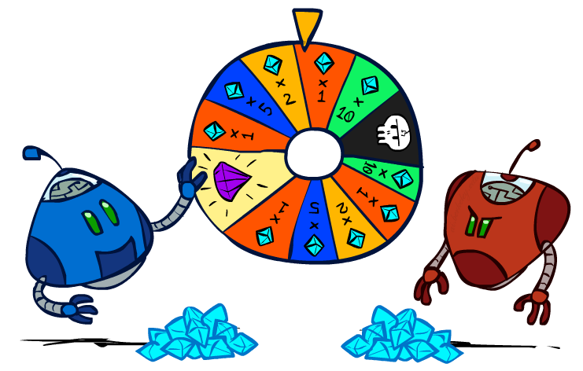
UWO CS AI I – CS 188: Artificial Intelligence Modified by Charles Ling
Uncertainty and Utilities (Chapter 5.5 – 5.8, 16.1 – 16.3)
Instructors: Dan Klein and Pieter Abbeel
University of California, Berkeley
[These slides were created by Dan Klein and Pieter Abbeel for CS188 Intro to AI at UC Berkeley. All CS188 materials are available at http://ai.berkeley.edu.]
Notes:
Please retain proper attribution, including the reference to ai.berkeley.edu. Thanks!

Slide 2
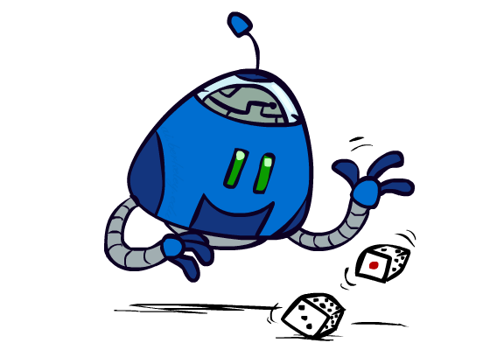
Uncertain Outcomes

Slide 3
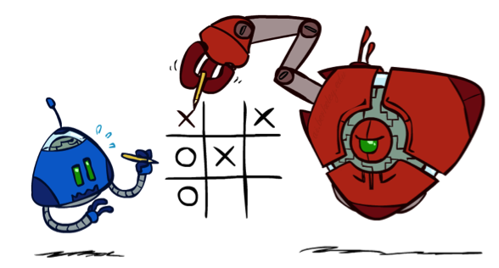

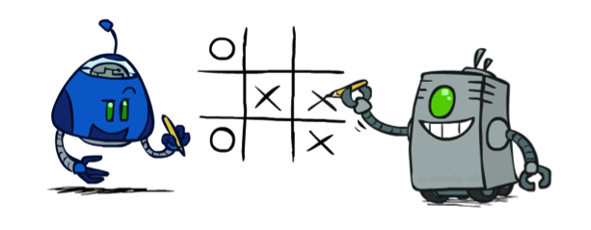
Worst-Case vs. Average Case
max
min
10
10
9
100
Idea: Uncertain outcomes controlled by chance, not an adversary!
(Or the adversary is “drunk”)
Notes:
At least 10, or otherwise just rather dead; or just 100, or otherwise rather dead; that’s yet something different than minimax or expectimax

Slide 4
Expectimax Search
Why wouldn’t we know what the result of an action will be?
Explicit randomness: rolling dice
Unpredictable opponents: the ghosts respond randomly
Actions can fail: when moving a robot, wheels might slip
Values should now reflect average-case (expectimax) outcomes, not worst-case (minimax) outcomes
Expectimax search: compute the average score under optimal play
Max nodes as in minimax search
Chance nodes are like min nodes but the outcome is uncertain
Calculate their expected utilities
I.e. take weighted average (expectation) of children
Later, we’ll learn how to formalize the underlying uncertain-result problems as Markov Decision Processes
max
chance
10
10
4
10
5
9
7
100
Demo
Know your opponent
Optimal but unlucky
In a long run, optimal
[Demo: min vs exp (L7D1,2)]

Slide 5
Expectimax Pseudocode
def value(state):
if the state is a terminal state: return the state’s utility
if the next agent is MAX: return max-value(state)
if the next agent is EXP: return exp-value(state)
def max-value(state):
initialize v = -∞
for each successor of state:
v = max(v, value(successor))
return v
def exp-value(state):
initialize v = 0
for each successor of state:
p = probability(successor)
v += p * value(successor)
return v
Notes:
Pick an order for two reasons: sequential processor and pruning

Slide 6
Expectimax Pseudocode
def exp-value(state):
initialize v = 0
for each successor of state:
p = probability(successor)
v += p * value(successor)
return v
1/2
1/6
1/3
5
8
7
24
-12
v = (1/2) (8) + (1/3) (24) + (1/6) (-12) = 10

Slide 7
Expectimax Example
3
12
9
2
4
6
15
6
0

Slide 8
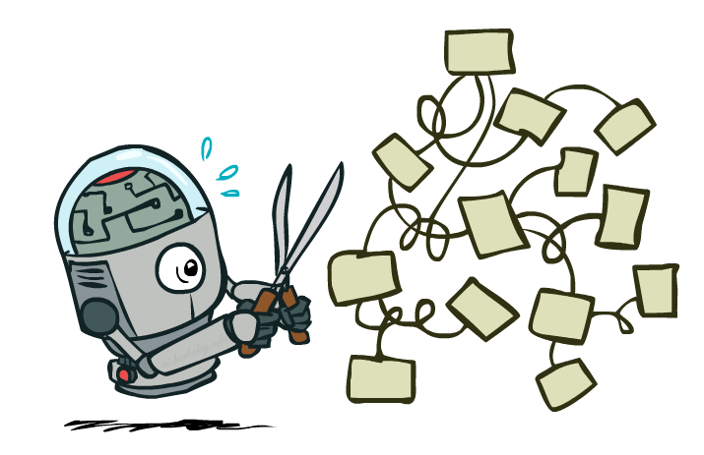
Expectimax Pruning?
3
12
9
2

Slide 9



Depth-Limited Expectimax
Estimate of true expectimax value (which would require a lot of work to compute)
400
300
…
…
492
362
…

Slide 10
Utility Values and Optimal Decision Making
0
40
20
30
x²
0
1600
400
900
In minimax tree, only order matters (move to right)
In expectimax tree, magnitudes are important (move to left)
Accurate utility is important: [bad, good] < [bad, OK, good]< [0, 100] even though the decision is discrete (left or right) !
If no difference in utility values, no “optimal” decisions

Slide 11
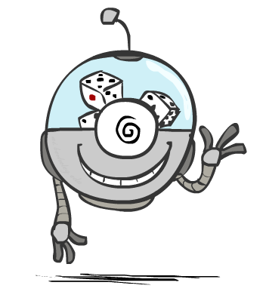
Probabilities

Slide 12
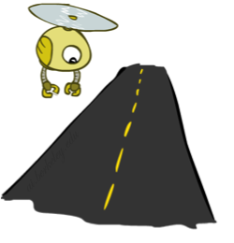
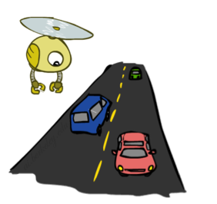
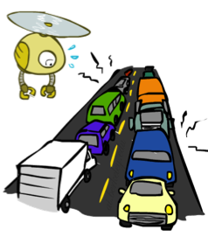
Reminder: Probabilities
A random variable represents an event whose outcome is unknown
A probability distribution is an assignment of weights to outcomes
Example: Traffic on freeway (we can learn those prob.)
Random variable: T = whether there’s traffic
Outcomes: T in {none, light, heavy}
Distribution: P(T=none) = 0.25, P(T=light) = 0.50, P(T=heavy) = 0.25
Some laws of probability (more later):
Probabilities are always non-negative
Probabilities over all possible outcomes sum to one
As we get more evidence, probabilities may change:
P(T=heavy) = 0.25, P(T=heavy | Hour=8am) = 0.60
We’ll talk about methods for reasoning and updating probabilities later
(Discrete here but can be continuous: prob. density function)
0.25
0.50
0.25

Slide 13
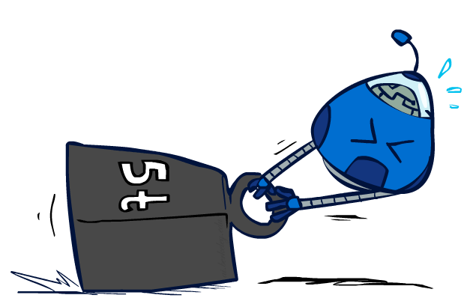
Reminder: Expectations
The expected value of a function of a random variable is the average, weighted by the probability distribution over outcomes
Example: How long to get to the airport?
Time:
20 min
30 min
60 min
+
+
35 min
x
x
x
Probability:
0.25
0.50
0.25

Slide 14

What Probabilities to Use?
In expectimax search, we have a probabilistic model of how the opponent (or environment) will behave in any state (must “model” the opponent)
Model could be a simple uniform distribution (roll a die)
Model could be sophisticated and require a great deal of computation
We have a chance node for any outcome out of our control: opponent or environment
The model might say that adversarial actions are likely!
For now, assume each chance node magically comes along with probabilities that specify the distribution over its outcomes
Having a probabilistic belief about another agent’s action does not mean that the agent is flipping any coins!

Slide 15
Quiz: Informed Probabilities
Let’s say you know that your opponent is actually running a depth 2 minimax, using the result 80% of the time, and moving randomly otherwise
Question: What tree search should you use?
Answer: Expectimax!
To figure out EACH chance node’s probabilities, you have to run a simulation of your opponent
This kind of thing gets very slow very quickly
Even worse if you have to simulate your opponent simulating you…
… except for minimax, which has the nice property that it all collapses into one game tree
0.8 0.2
Know your “enemies” but don’t let them know that you know…

Slide 16

Modeling Assumptions

Slide 17
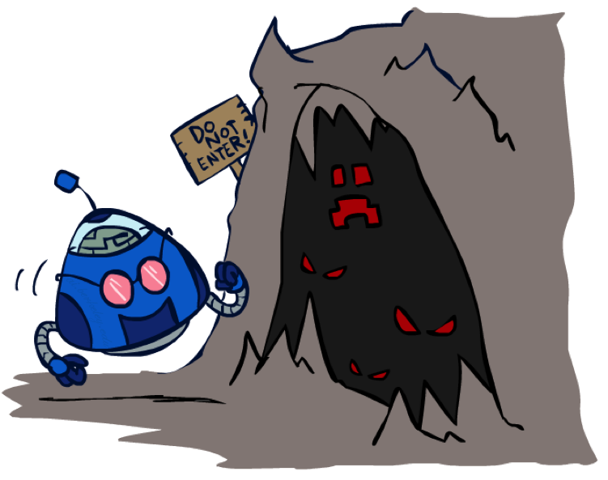
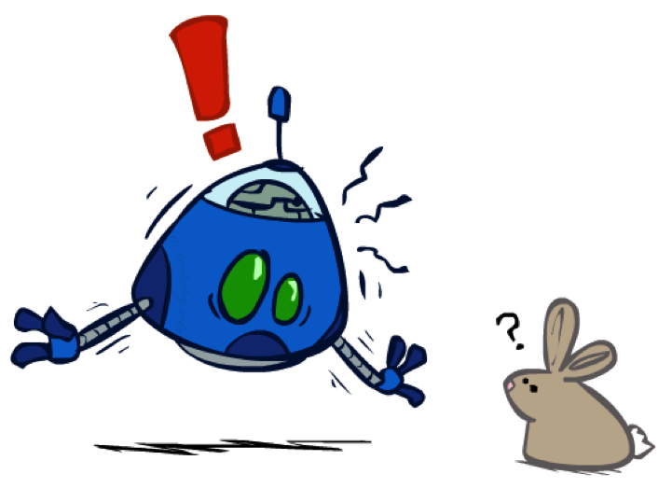
The Dangers of Optimism and Pessimism
Dangerous Optimism
Assuming chance when the world is adversarial
Dangerous Pessimism
Assuming the worst case when it’s not likely

Slide 18
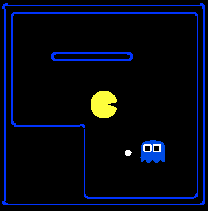
Assumptions vs. Reality
 | Adversarial Ghost | Random Ghost
Minimax Pacman | Won 5/5 Avg. Score: 483 | Won 5/5 Avg. Score: 493
Expectimax Pacman | Won 1/5 Avg. Score: -303 | Won 5/5 Avg. Score: 503
Results from playing 5 games
Demo: Know your opponent!
Pacman used depth 4 search with an eval function that avoids trouble Ghost used depth 2 search with an eval function that seeks Pacman
[Demos: world assumptions (L7D3,4,5,6)]
Notes:
Ling: BR and TL is the optimal Pacman; BL (usually bad) and TR (inefficient) is not
python pacman.py -g SmartGhost -l trapped2 -p ExpectimaxAgent -a depth=4,evalFn=better

Slide 19
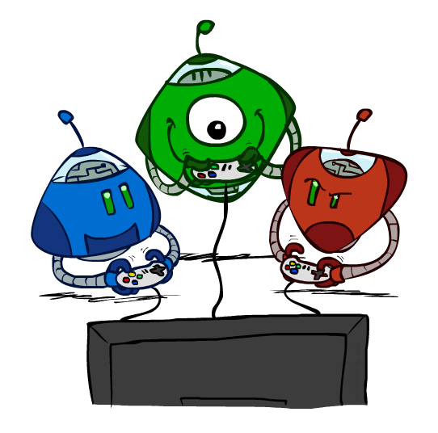
Other Game Types

Slide 20



Mixed Layer Types
E.g. Backgammon
Expectiminimax
Environment is an extra “random agent” player that moves after each min/max agent
Each node computes the appropriate combination of its children
How to play Backgammon?
Notes:
If it’s terminal or we reached our depth limit, return utility

Slide 21
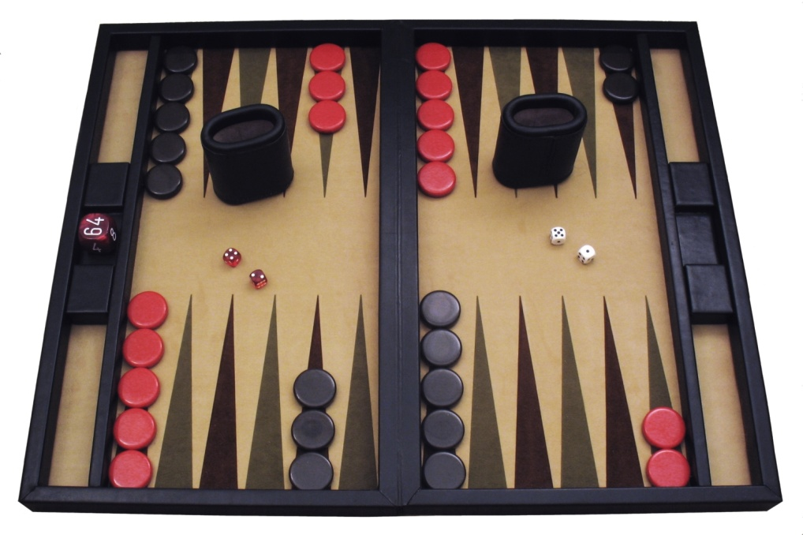
Example: Backgammon
Dice rolls increase b: 21 possible rolls with 2 dice
Backgammon ≈ 20 legal moves
Depth 2 = 20 x (21 x 20)³ = 1.2 x 10⁹
As depth increases, probability of reaching a given search node shrinks
So usefulness of search is diminished
So limiting depth is less damaging
But pruning is trickier…
Historic AI: TDGammon uses depth-2 search + very good evaluation function + reinforcement learning: world-champion level play
1st AI world champion in any game!
Image: Wikipedia

Slide 22
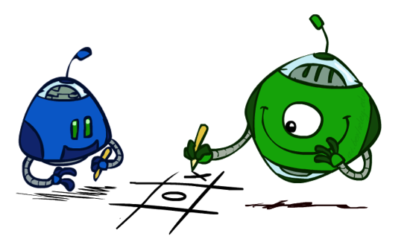
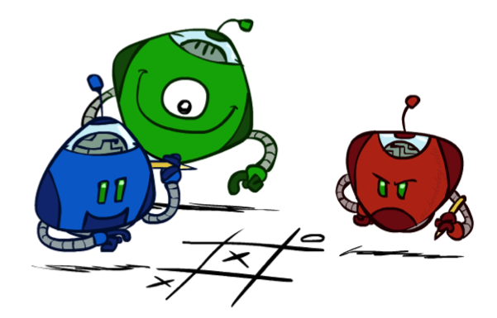
Multi-Agent Utilities
What if the game is not zero-sum, or has multiple players? Zero-sum is a special case
Generalization of minimax:
Terminals have utility tuples
Node values are also utility tuples
Each player maximizes its own component
Can give rise to cooperation and
competition dynamically…
via search algorithms!
5,2,5
1,6,6
5,2,5
1,6,6
6,1,2
5,1,7
5,2,5
1,6,6
7,1,2
6,1,2
7,2,1
5,1,7
1,5,2
7,7,1
5,2,5

Slide 23
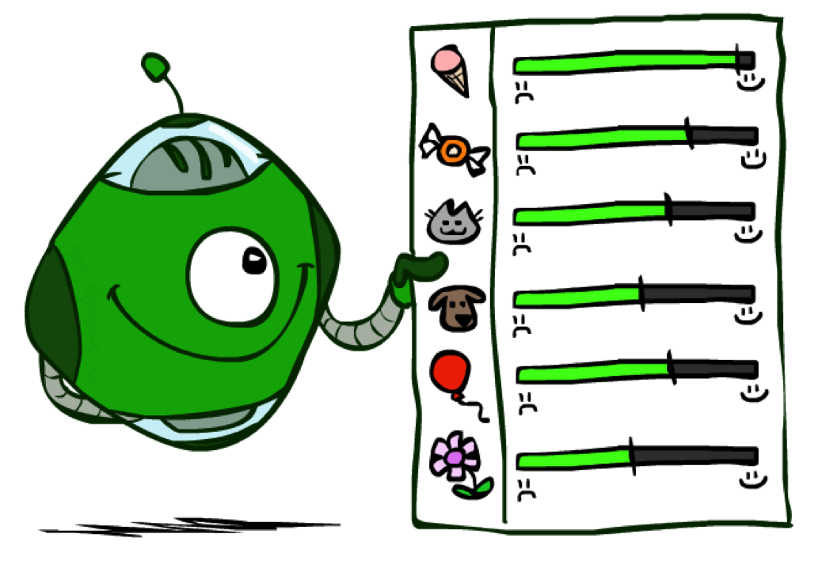
Utilities

Slide 24

Maximum Expected Utility
Why should we average utilities? Why not minimax?
Principle of maximum expected utility:
A rational agent should chose the action that maximizes its expected utility, given its knowledge
Questions:
Where do utilities come from?
How do we know such utilities even exist?
How do we know that averaging even makes sense?
What if our behavior (preferences) can’t be described by utilities?

Slide 25

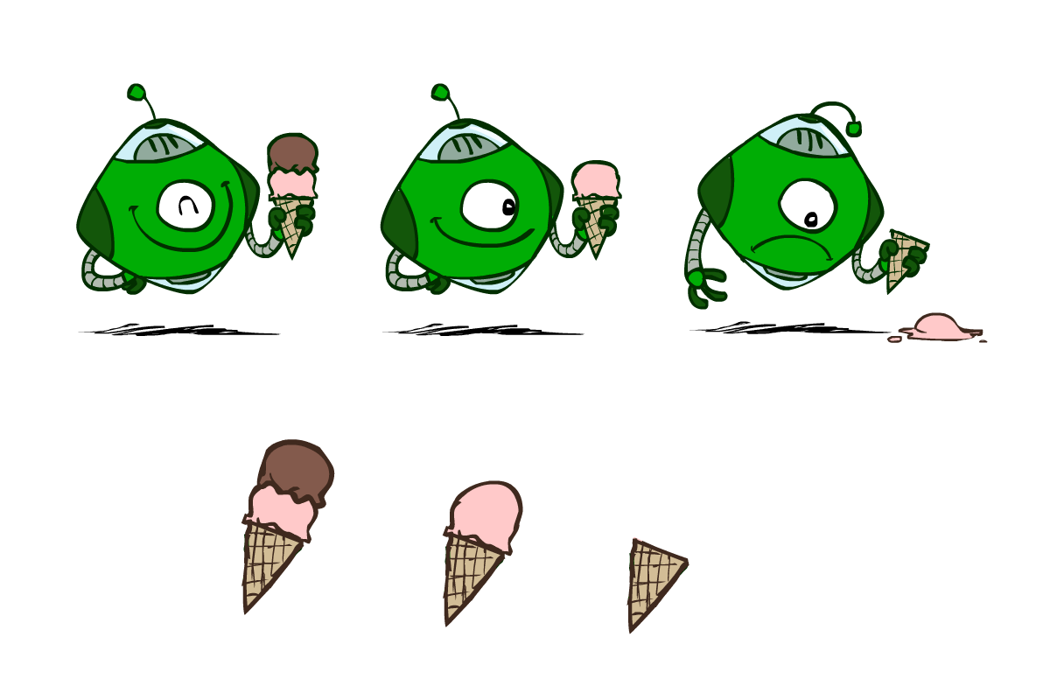
Utilities
Utilities are functions from outcomes (states of the world) to real numbers that describe an agent’s preferences
Where do utilities come from?
In a game, may be simple (+1/-1)
Utilities summarize the agent’s goals (in one number)
Theorem: any “rational” preferences can be summarized as a utility function
We hard-wire utilities (defined externally) and let behaviors emerge
Why don’t we let agents pick utilities?
Why don’t we prescribe behaviors?
Must define utility carefully!

Slide 26
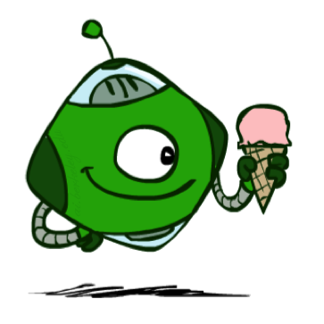
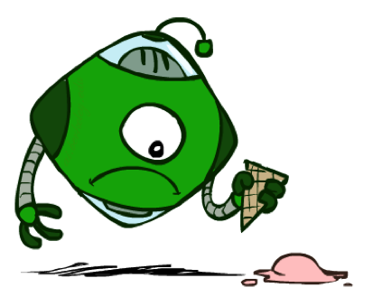
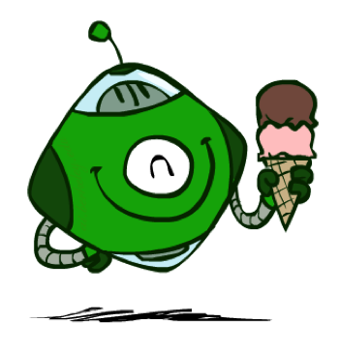
Utilities: Uncertain Outcomes
Getting ice cream
Get Single
Get Double
Oops
Whew!

Slide 27
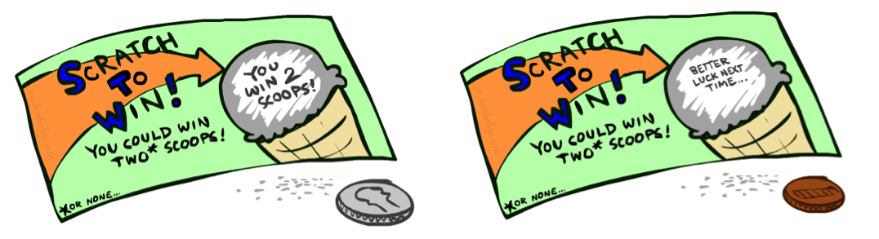
Preferences
A Prize
A Lottery (prob.)
An agent must have preferences among:
Prizes: A, B, etc. (utility values)
Lotteries: situations with uncertain prizes
Notation:
Preference:
Indifference:
C
p 1-p
A B

Slide 28
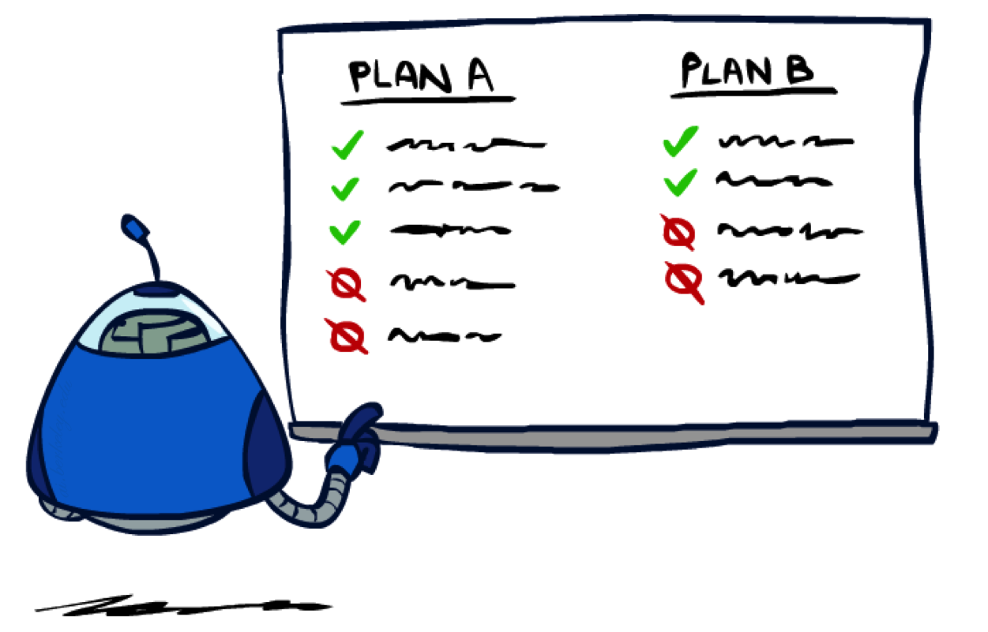
Rationality

Slide 29
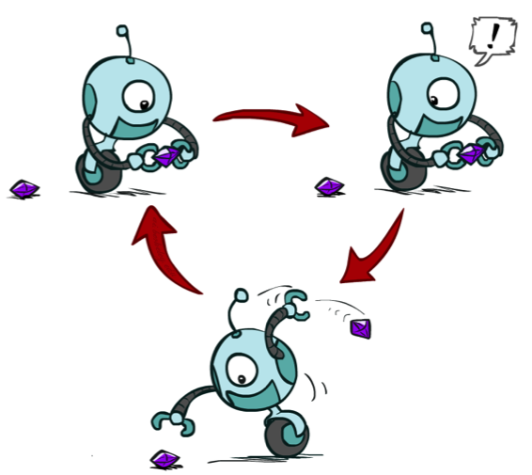
Rational Preferences
We want some constraints on preferences before we call them rational, such as:
For example: an agent with intransitive preferences can
be induced to give away all of its money
If B > C, then an agent with C would pay (say) 1 cent to get B
If A > B, then an agent with B would pay (say) 1 cent to get A
If C > A, then an agent with A would pay (say) 1 cent to get C
Axiom of Transitivity:
A > B and B > C => A > C
Must be consistent…
Eg: I prefer summer over winter because… I prefer winter over summer because …
Notes:
Apple, banana, carrot

Slide 30

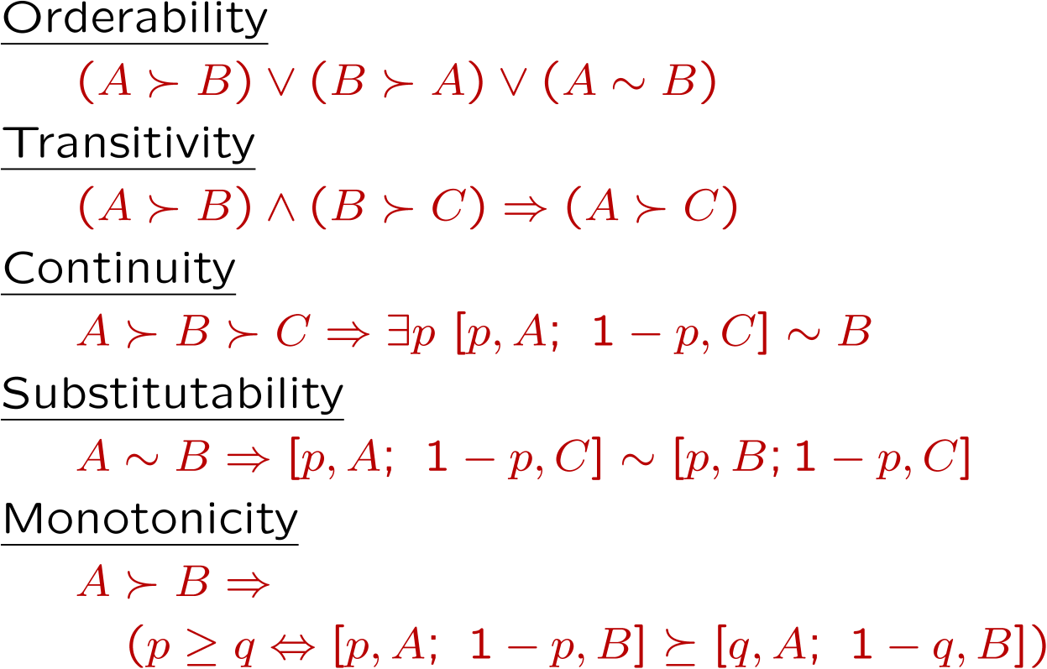
Rational Preferences
The Axioms of Rationality
Theorem: Rational preferences imply behavior describable as maximization of expected utility

Slide 31
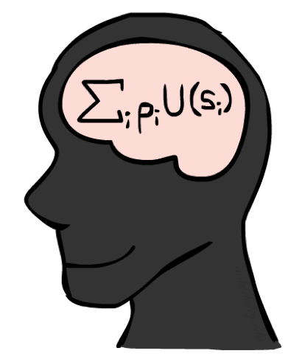
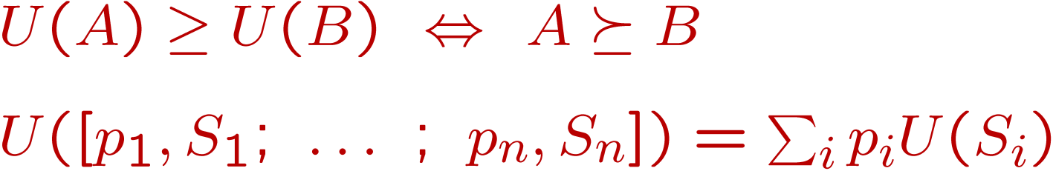
MEU Principle
Theorem [Ramsey, 1931; von Neumann & Morgenstern, 1944]
Given any preferences satisfying these constraints, there exists a real-valued
function U such that:
I.e. values assigned by U preserve preferences of both prizes and lotteries!
Maximum expected utility (MEU) principle:
Choose the action that maximizes expected utility (discrete actions, infinite utility values)
Note: an agent can be entirely rational (consistent with MEU) without ever representing or manipulating utilities and probabilities
E.g., a lookup table for perfect tic-tac-toe, a reflex vacuum cleaner

Slide 32
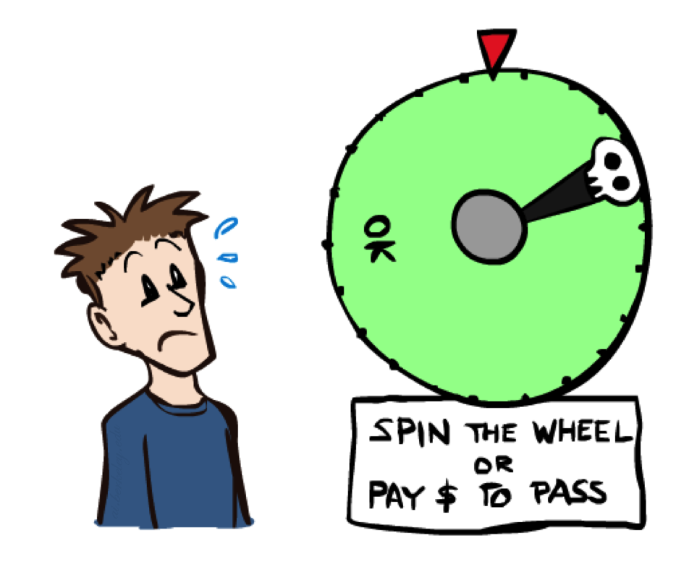
Human (Agent) Utilities

Slide 33

Utility Scales
Normalized utilities: u₊ = 1.0, u₋ = 0.0
Micromorts: one-millionth chance of death, useful for paying to reduce product risks, etc.
QALYs: quality-adjusted life years, useful for medical decisions involving substantial risk
Note: behavior is invariant under positive linear transformation
With deterministic prizes only (no lottery choices), only ordinal utility can be determined, i.e., total order on prizes

Slide 34


Human Utilities
Utilities map states to real numbers. Which numbers?
Standard approach to assessment (elicitation) of human utilities:
Compare a prize A to a standard lottery L_{p} between
“best possible prize” u₊ with probability p
“worst possible catastrophe” u₋ with probability 1-p
Adjust lottery probability p until indifference: A ~ L_{p}
Resulting p is a utility in [0,1]
Pay $30
0.999999 0.000001
No change
Instant death
If 1/1000 of death, how much you’d pay to get out?
If 1/10,000 of death, would you give up a certain “fun” activity?

Slide 35
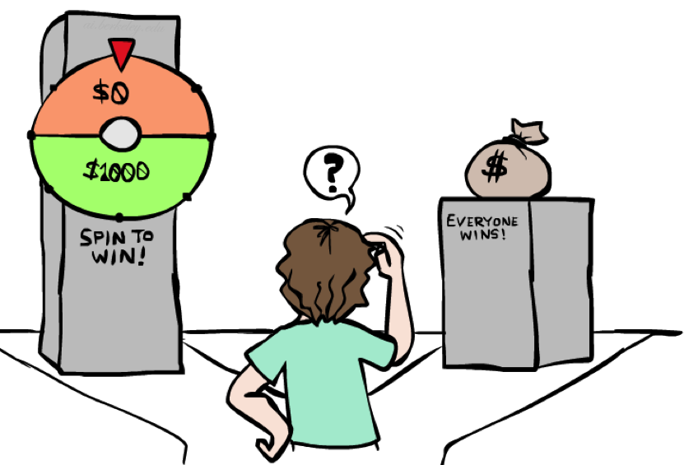
Money
Money does not behave as a utility function, but we can talk about the utility of having money (or being in debt)
Given a lottery L = [p, $X; (1-p), $Y]
The expected monetary value EMV(L) is p*X + (1-p)*Y
U(L) = p*U($X) + (1-p)*U($Y)
Typically, U(L) < U( EMV(L) )
In this sense, people are risk-averse
When deep in debt, people are risk-prone
You get either:
$1m for sure (prize)
- $3m with 50% lottery
- Charge higher taxes for high income
- Bill Gates donates money…
Social programs
…
Notes:
Draw Jensen’s for utility curve

Slide 36
Example: Insurance
Consider the lottery [0.5, $1000; 0.5, $0]
What is its expected monetary value? ($500)
What is its certainty equivalent?
Monetary value acceptable in lieu of lottery
$400 for most people
Difference of $100 is the insurance premium
There’s an insurance industry because people will pay to remove their risk (of losing $1k)
If everyone were risk-neutral, no insurance needed!
It’s win-win: you’d rather have the $400 and the insurance company would rather have the lottery (their utility curve is flat and they have many lotteries)

Slide 37

Example: Human Rationality?
Famous example of Allais (1953)
A: [0.8, $4k; 0.2, $0]
B: [1.0, $3k; 0.0, $0]
C: [0.2, $4k; 0.8, $0]
D: [0.25, $3k; 0.75, $0]
Most people prefer B > A, C > D
But if U($0) = 0, then
B > A ⇒ U($3k) > 0.8 U($4k)
C > D ⇒ 0.8 U($4k) > U($3k)

Slide 38
Behavioral Economics
Richard Thaler (2017 Nobel Prize in Economics)
1974 PhD: "The Value of Saving A Life: A Market Estimate“
0.1% chance of death, how much to pay to prevent it?
How much to be paid to go to an area with 0.1% chance of death
Quarantine: depression, economic loss (~lost of N days of life)
Smoking, …, various spots, high-risk activities/jobs, …
Car prices vs fatality rate
Flight vs long drive
…

Slide 39
What are Probabilities?
Objectivist / frequentist answer:
Averages over repeated experiments
E.g. empirically estimating P(rain) from historical observation
Assertion about how future experiments will go (in the limit)
New evidence changes the reference class
Makes one think of inherently random events, like rolling dice
Subjectivist / Bayesian answer:
Degrees of belief about unobserved variables
E.g. an agent’s belief that it’s raining, given the temperature
E.g. pacman’s belief that the ghost will turn left, given the state
Often learn probabilities from past experiences (more later)
New evidence updates beliefs (more later)

Slide 40
Uncertainty Everywhere
Not just for games of chance!
I’m sick: will I sneeze this minute?
Email contains “FREE!”: is it spam?
Tooth hurts: have cavity?
60 min enough to get to the airport?
Robot rotated wheel three times, how far did it advance?
Safe to cross street? (Look both ways!)
Sources of uncertainty in random variables:
Inherently random process (dice, etc)
Insufficient or weak evidence
Ignorance of underlying processes
Unmodeled variables
The world’s just noisy – it doesn’t behave according to plan!
Compare to fuzzy logic, which has degrees of truth, rather than just degrees of belief

